Slide 1
Analyzing the trends in Recipe and Ingredients used by Bohra Community

Slide 2
Introduction

Slide 3
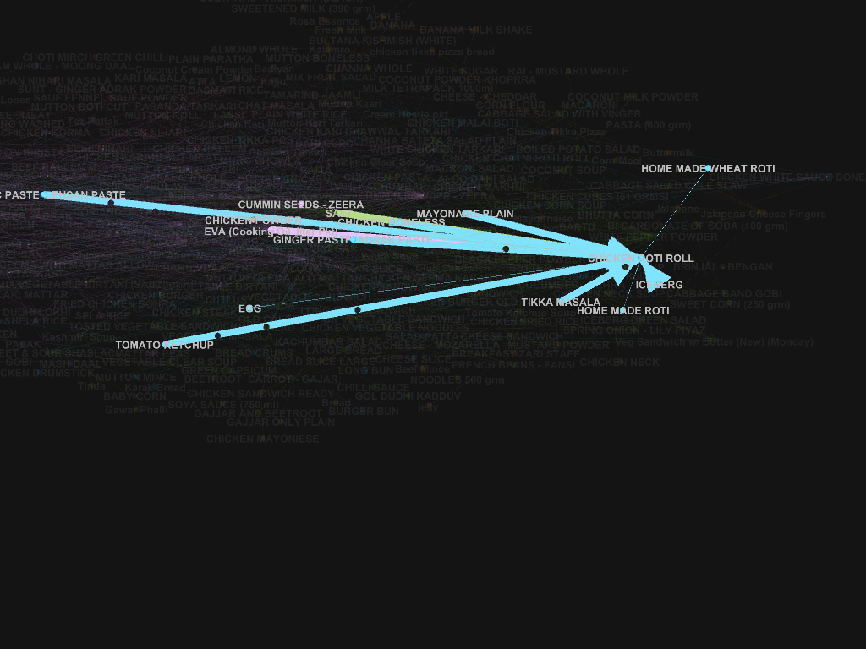
Why this project?
If you see Recipe and its relationship with Ingredient a graph can be set

Slide 4
Why this project?
Graph can be used to find out interesting facts. Some Research about the Food Pattern are
To Find out person region based on the food it eats.( Paper : You Are What You Eat Exploring Rich Recipe Information for Cross-Region Food Analysis)
Recipe generation based on available ingredients in kitchen. (Paper : Characterize ingredient network for recipe suggestion)

Slide 5
What are the goals?
To get such pattern which can identify Important ingredient to help in better Inventory Management

Slide 6
How did you gather data and describe the data
We have got that data of Bohra Community Jammat Kahana

Slide 7
Data Visualization

Slide 8
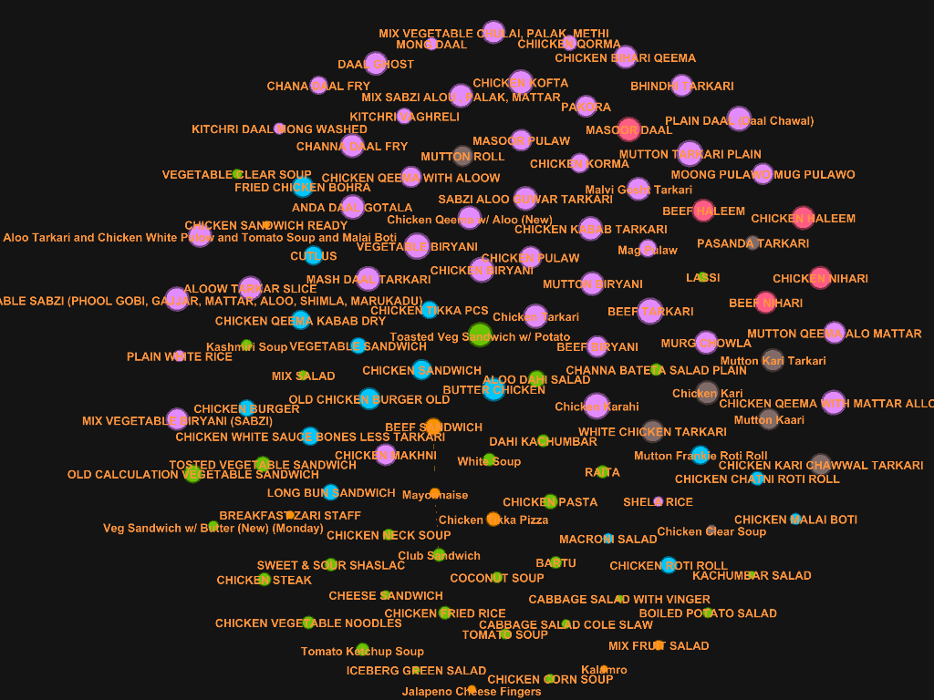
Authority

Slide 9
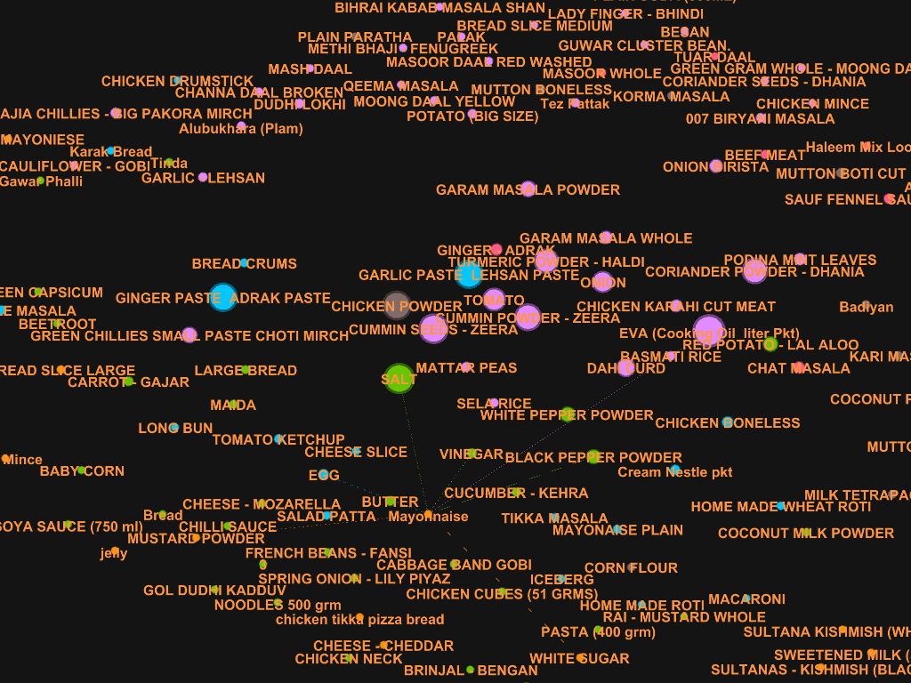
Hub

Slide 10
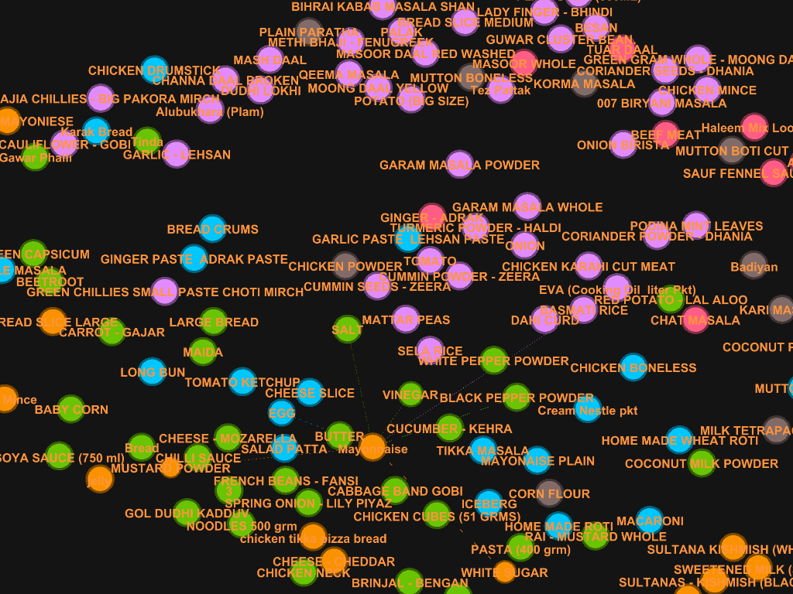
Closeness

Slide 11
Modularity

Slide 12
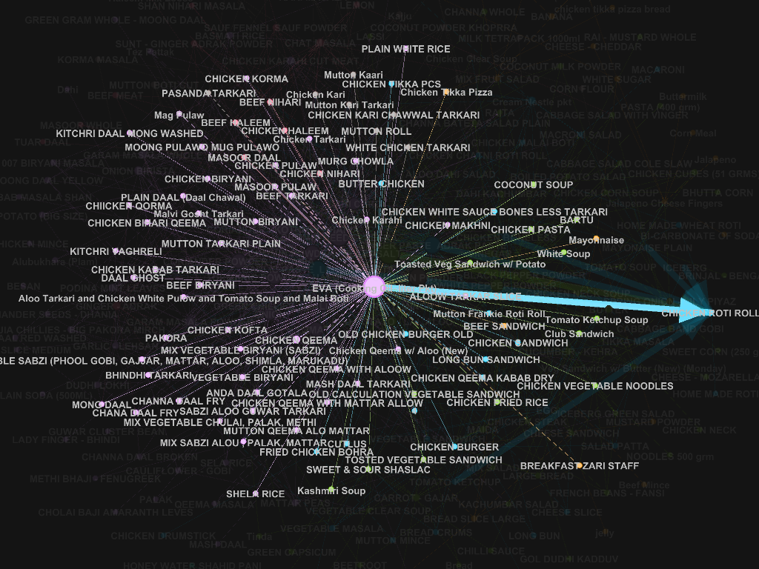
In Degree

Slide 13
Results
We find that Hub Represents the importance of nodes with respect to inventory.
EVA (Cooking Oil liter Pkt)
SALT
CUMMIN SEEDS - ZEERA
GARLIC PASTE LEHSAN PASTE
GINGER PASTE ADRAK PASTE
CHICKEN POWDER
CUMMIN POWDER - ZEERA
CORIANDER POWDER - DHANIA
TURMERIC POWDER - HALDI
TOMATO

